Slide 1

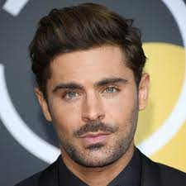
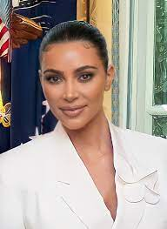
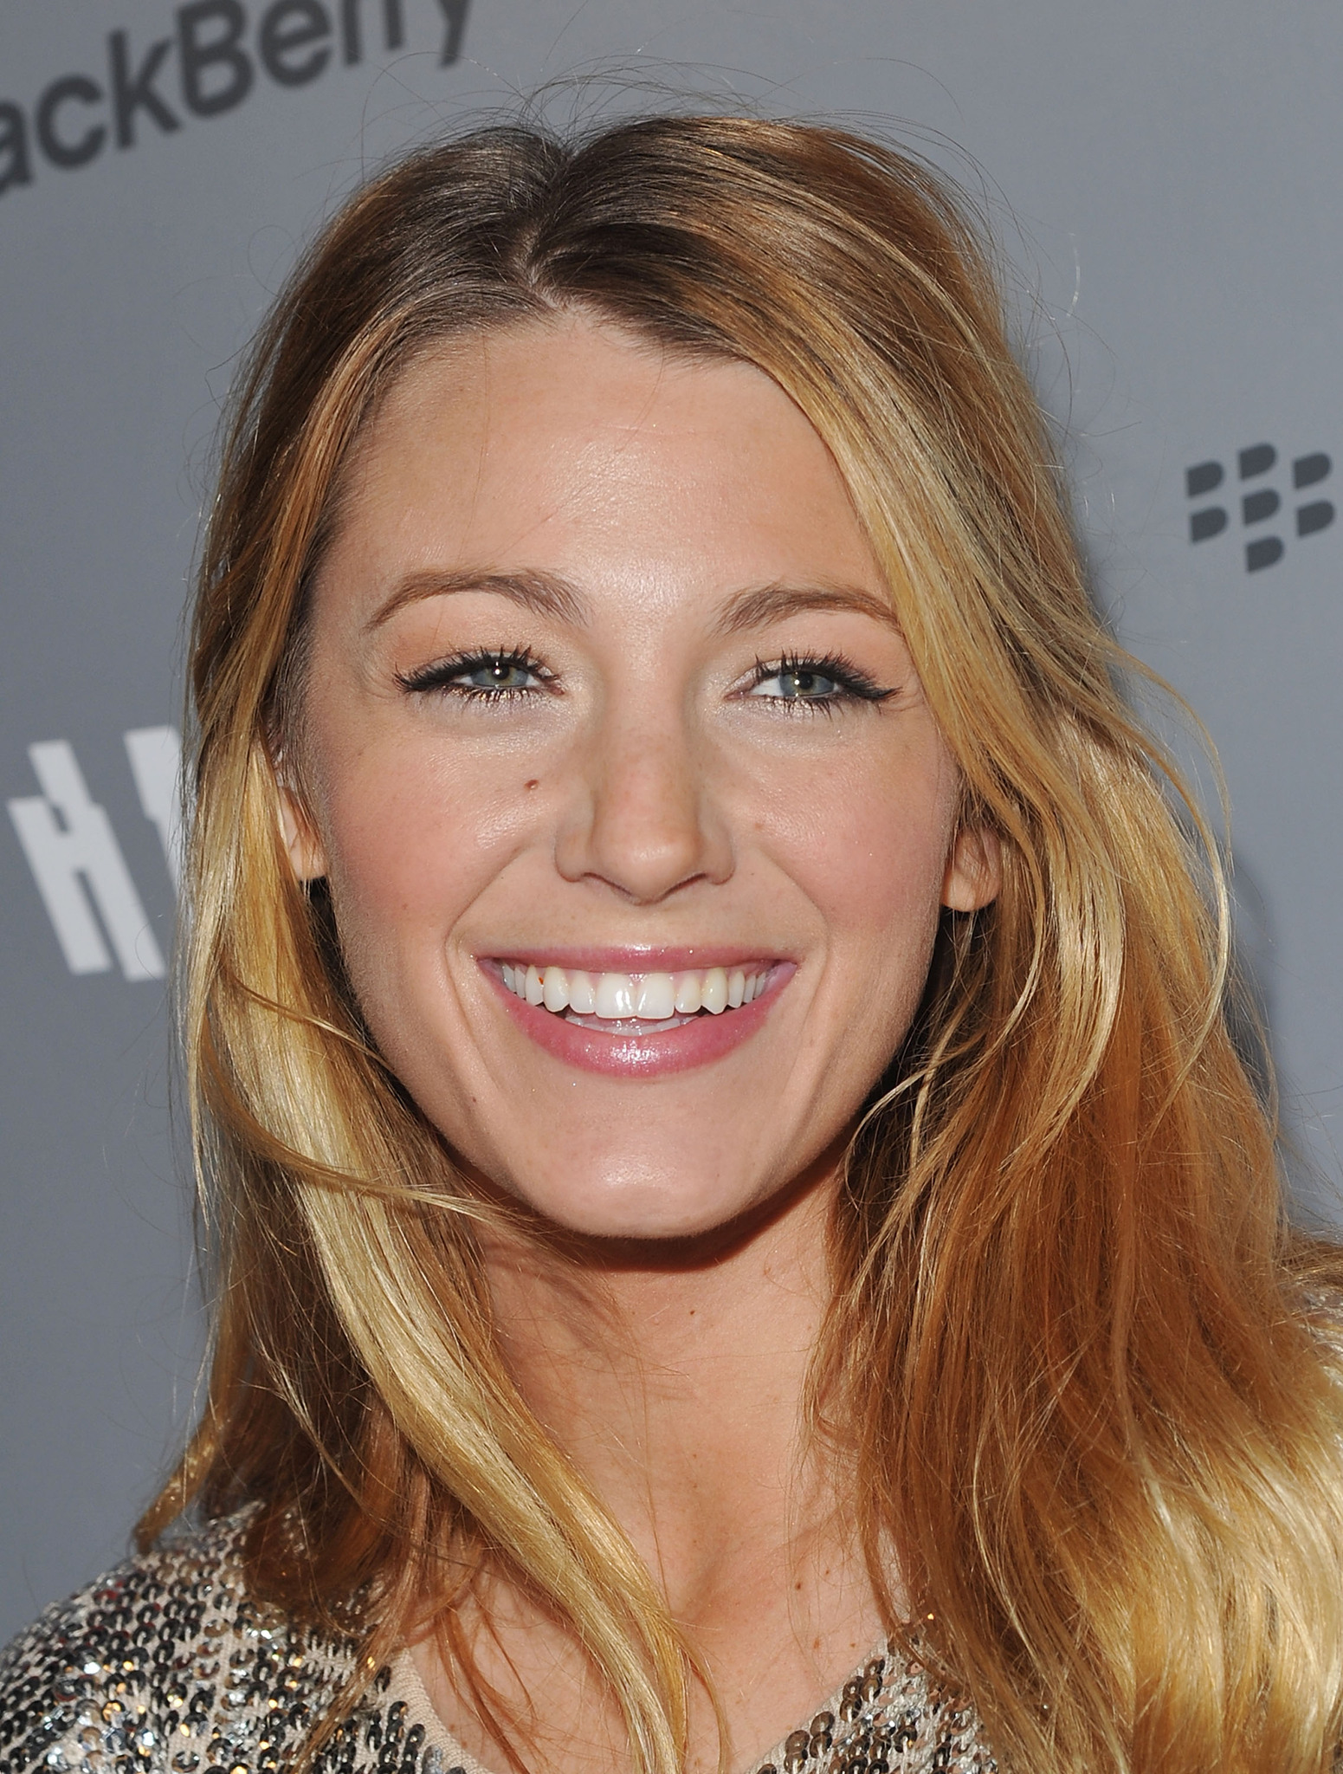
A Study on Celebrity Faces
Narin
Dhatwalia
Jason
Summer
Naomi
Zhang
Simon
Zhu

Slide 2
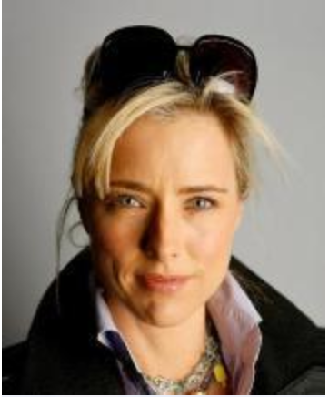
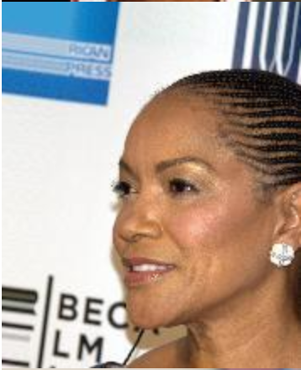
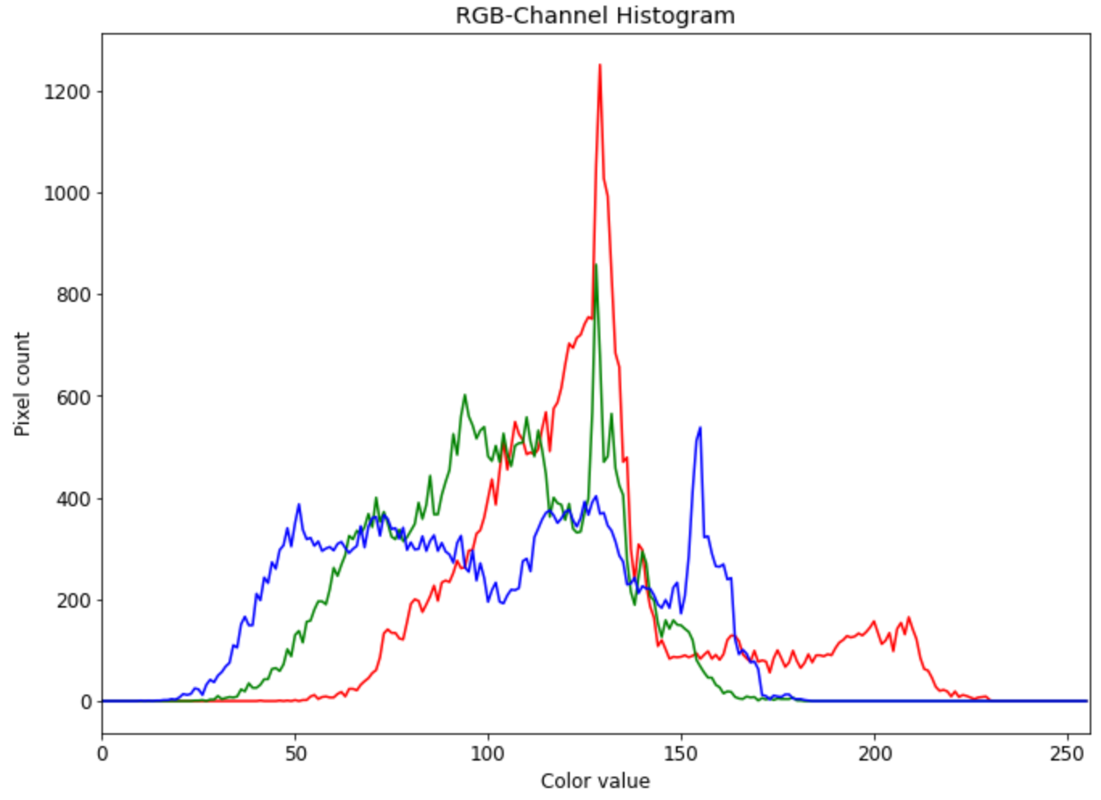
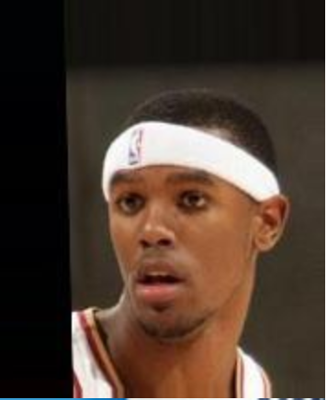
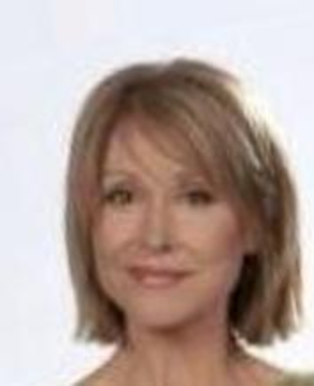
Celebrity Face Dataset
Over 200K images of celebrity faces with 40 binary attribute annotations for each.
eyeglasses
smiling
hat

Slide 3
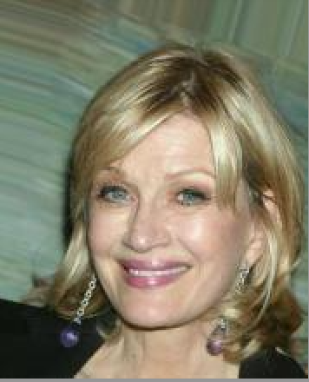
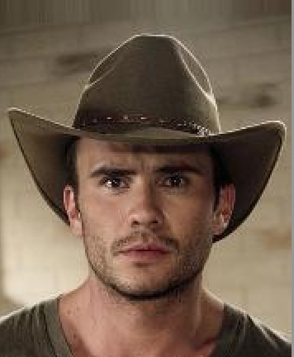
Binary Classification: Smiling
vs

Slide 4
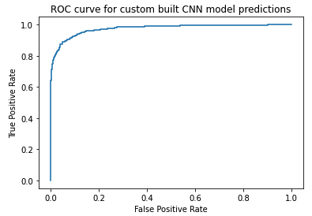
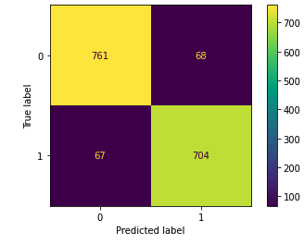
Custom Model
Model Makeup
Three convolutional blocks, each containing
2 convolutional layers
Kernel size : 4x4
Number of kernels: - 32 (block 1) - 64 (block 2) - 128 (block 3)
1 max-pooling layer with pool-size 2x2
2 batch-normalization layers
1 dropout layer
Activation function: Elu
Kernel regularizer: L2
Adam optimizer
Adapting learning rate scheduler
Performance
accuracy: 0.921
precision: 0.912
recall: 0.913
Training Procedure
Batch size of 32
Training over 100 epochs

Slide 5
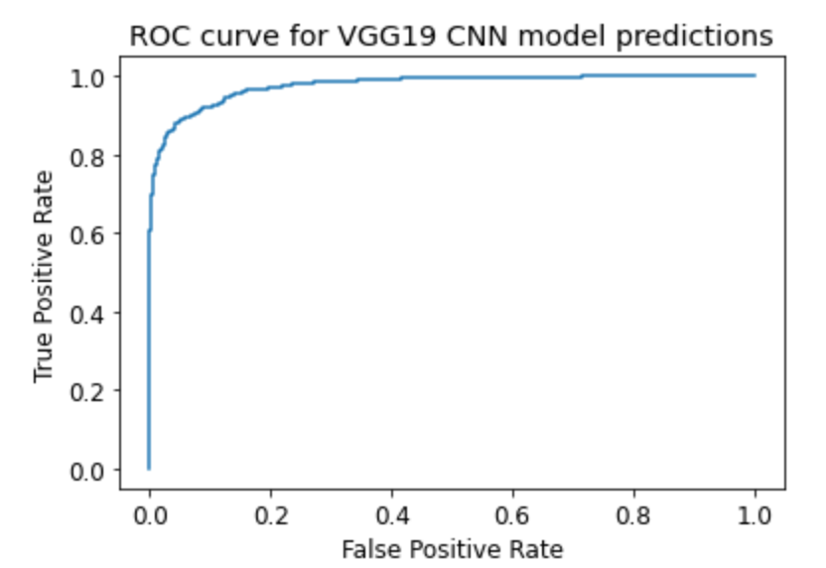
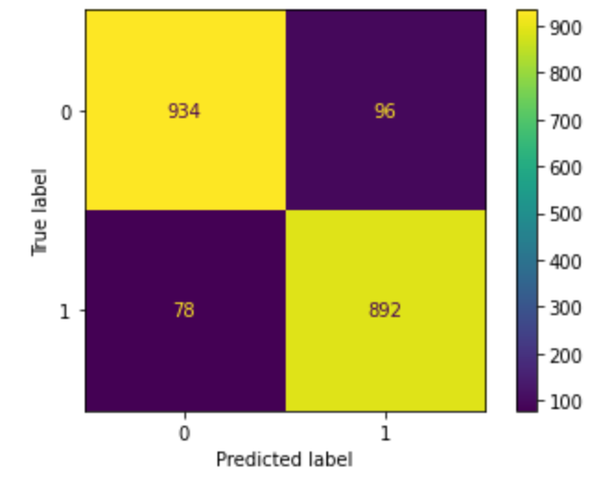
VGG19 Pre-Trained
Model Makeup
VGG19 pre-trained model using ImageNet data
Last 8 layers unfrozen for training
2 additional convolutional layers with `tanh` activation function (3x3) kernel
Max pooling and flattening layers
2 Dense layers with `relu` and `sigmoid` activation, respectively
Adam optimizer
Performance
accuracy: 0.913
precision: 0.903
recall: 0.920
Training Procedure
Batch size of 64
Training over 20 epochs

Slide 6
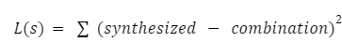
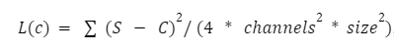
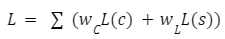
Style Transfer
Loss Functions
Style Loss
compares the loss of style features between the style image and the synthesized image
S is the gram matrix of the style image and C is the gram matrix of the synthesized (combined) image.
channels refer to the RGB channels, where it takes a constant value of 3.
Content Loss
loss of content features between the content image and the newly synthesized image
Total Loss
weighted sum of both is used to evaluate the final image in order to balance content retention and the actual style transfer
content weight loss wc is a predefined constant and the style weight loss wL is a predefined constant divided by the total number of style layers

Slide 7
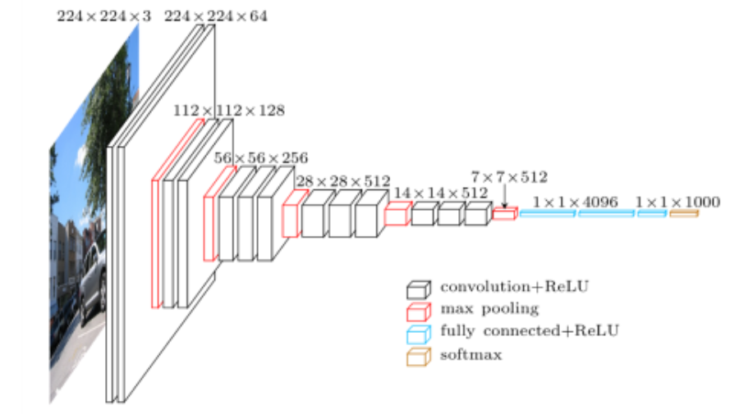
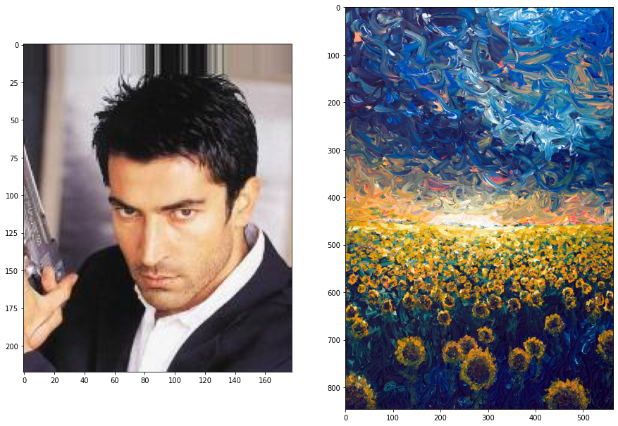
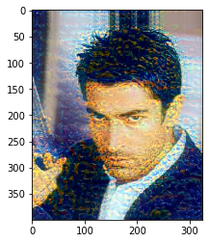
Style Transfer:
VGG16 Pre-Trained
Model Makeup
VGG16 pre-trained model using ImageNet data
Style Layers: ["block1_conv1", "block2_conv1", "block3_conv1", "block4_conv1", "block5_conv1"]
Content Layer: "block5_conv2"
Training Procedure
Image generation epochs: 5,000
Style Transfer Loss: 195.63 (10,000 iterations)

Slide 8
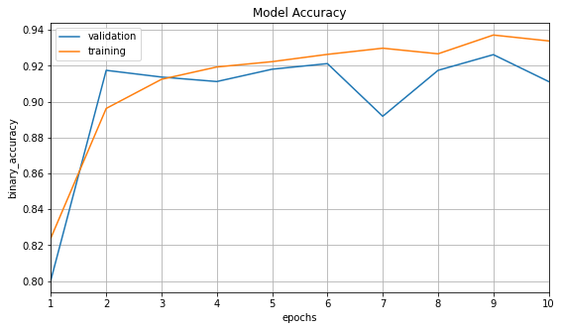
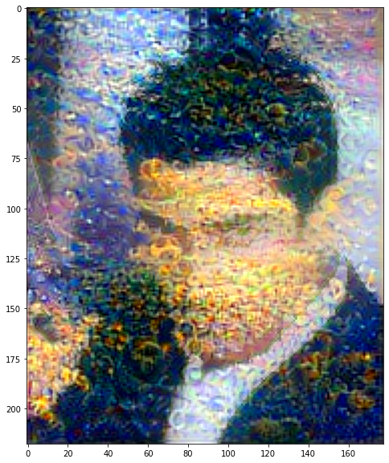
Style Transfer: VGG19 Transfer Learning
Style Layers are ["block1_conv1", "block2_conv1", "block3_conv1", "block4_conv1", "block5_conv1", “block6_conv1”] and Content Layer is "block6_conv2”
Final Model Architecture: - Unfreeze last 8 layers of VGG19 - Add Conv2d() layer - Add Conv2d() layer - Add MaxPooling2d() layer - Add Flatten() layer - Add Dense(activation = ‘relu’) layer - Add Dense(activation = ‘sigmoid’) layer
The model described above is trained to accomplish the same binary classification task of smile vs. no smile. However, the new feature maps learned during training are quite beneficial for improving the results of style transfer (as is evident from the significant decreased style transfer loss of 195.63)

Slide 9






Model Deployment and Maintenance (Smiling Classification)
Retrain the model with the new dataset after 100 new images have been added
Model
GUI
ECS
Feedback
Our Model
User Interface
Deployed Web Service
User Feedbacks
GUI built via Flask/Tkinter calls the built model
Add user inputs and labels back to the dataset
Trained model object
Deploy the app/GUI on ECS

Slide 10
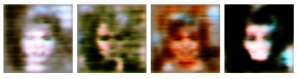
Conclusion
Findings and Further Work
Findings
Classification
Smiles can be detected with high level of accuracy
Both transfer learning with VGG19 model and custom model achieve similar performance
Style Transfer
Pretrained VGG16 generates images that do well on content transfer but lack the ability to capture style
VGG19 with transfer learning generates images that seem more like paintings, but at the cost of sharp detailing
Further Work
CNN can be trained for object detection on unlabeled data:
facial recognition problem (Zhong et al.)
facial identification (Guo et al.) and verification
facial clustering (Sun et al.) on unlabeled data
Proper segmentation of facial images split to identify facial structures and image features:
identify pose and age (Cao et al.)
develop models that better handle noisy or blurred inputs (Meng et al.)
Facial generation with simple DCGAN:

